Slide 1
DSCI 691
Trivia QA using NLP with Deep Learning
Project By:
Arnav Goel
Siddharth Dudugu
Michael Visco
Harsh Ramesh

Slide 2
Our Team
Arnav Goel(ag4273@drexel.edu); MS in Data Science
Siddharth Dudugu (sd3627@drexel.edu); MS in Data Science
Michael Visco (mjv64@drexel.edu); MS in AI & ML
Harsh Ramesh (hr439@drexel.edu); MS in Data Science

Slide 3
Project Overview
Goal: Train a model to answer trivia questions using the TriviaQA dataset.
Challenges:
Complex and compositional semantics of questions.
Complex reasoning, combining information from multiple sentences.
Difficulty in accurately extracting relevant information from the text.
NLP Task:
Train a deep residual neural network on the TriviaQA dataset.
Use the model to answer a wide range of trivia questions.
Neural Methodology: Embedding, Encoder, Attention, Evidence Processing, and Answer Prediction Layers.
Baselines: Human Answer Accuracy & Existing Models Accuracy.
Evaluation: Accuracy as the performance metric

Slide 4
Identification and Description of the Data
The only datasource we used for this project is the TriviaQA dataset found here: https://nlp.cs.washington.edu/triviaqa/
This dataset contains over 650k question-answer-evidence triples in json format.
It is separated into web evidence and wikipedia evidence categories and within those the data contained is the question, answer along with aliases of the answer and normalized versions of each, and finally search results relating to the question.
The most important parts of this data are the questions, normalized answer value for target training, and normalized answer aliases for judging accuracy.

Slide 5
Data Cleaning
Data Cleaning
Import necessary libraries & Initialize the dataset
Process the files & store content and label in a dictionary for each file, append it to the dataset list.
Dataset was JSON file in an unstructured format and had many unwanted columns, we extracted all the necessary columns and values from the original dataframe with specific column names.
Extract necessary columns: Question, Answers, Description
The resulting dataframe is then saved as a CSV file.
Handle missing values using the fillna() method.
These steps are crucial for preparing the data for further analysis and modeling.

Slide 6
Data Preprocessing
Models used: Simple Neural Network using Kera Sequential API and GloVe
Each pretrained model has its own data preprocessing layers. Steps involved in these pre-processing layers for the models:
Lowercasing answers: Perform on training, validation, and test sets to Normalize text and reduce vocabulary size.
Mapping labels to integers:Convert textual answers into a numerical format for model training.
Encoding labels:Represent answers as integer labels for classification.
Tokenizing questions: Convert questions into numerical sequences for input to the model.
Padding sequences:Ensure consistent input shape for the model.
These preprocessing layers are applied to the input data before passing it to the respective layers of the pretrained models
Proper data preprocessing ensures compatibility between the input data and the pretrained models
It is important to follow the specific preprocessing requirements of each pretrained model for optimal performance.

Slide 7
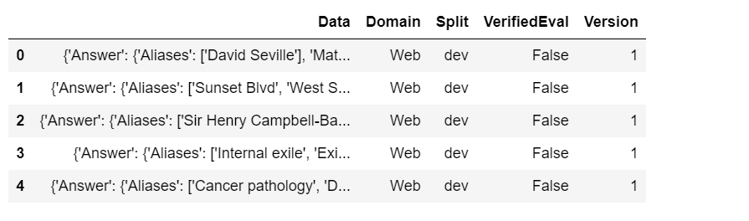
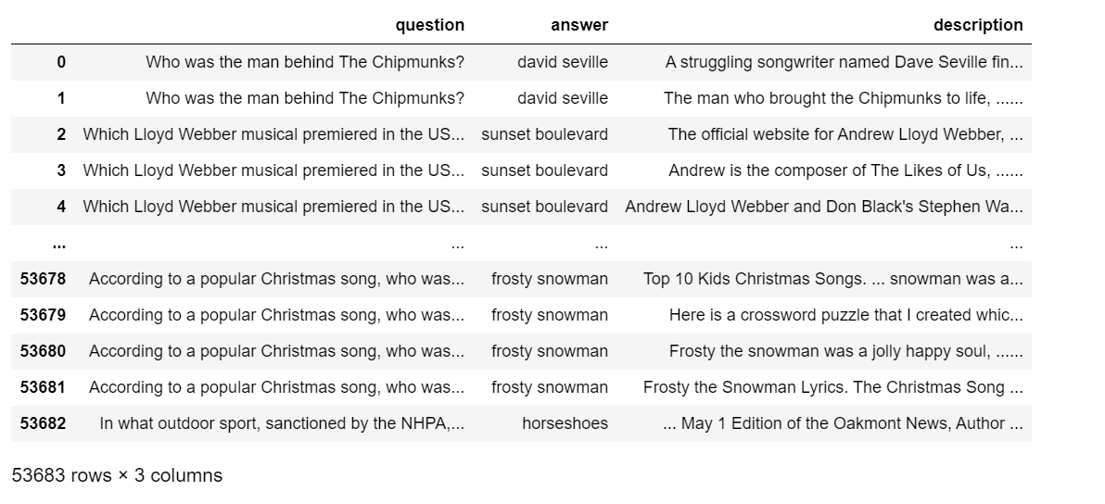
Data Visualizations

Slide 8
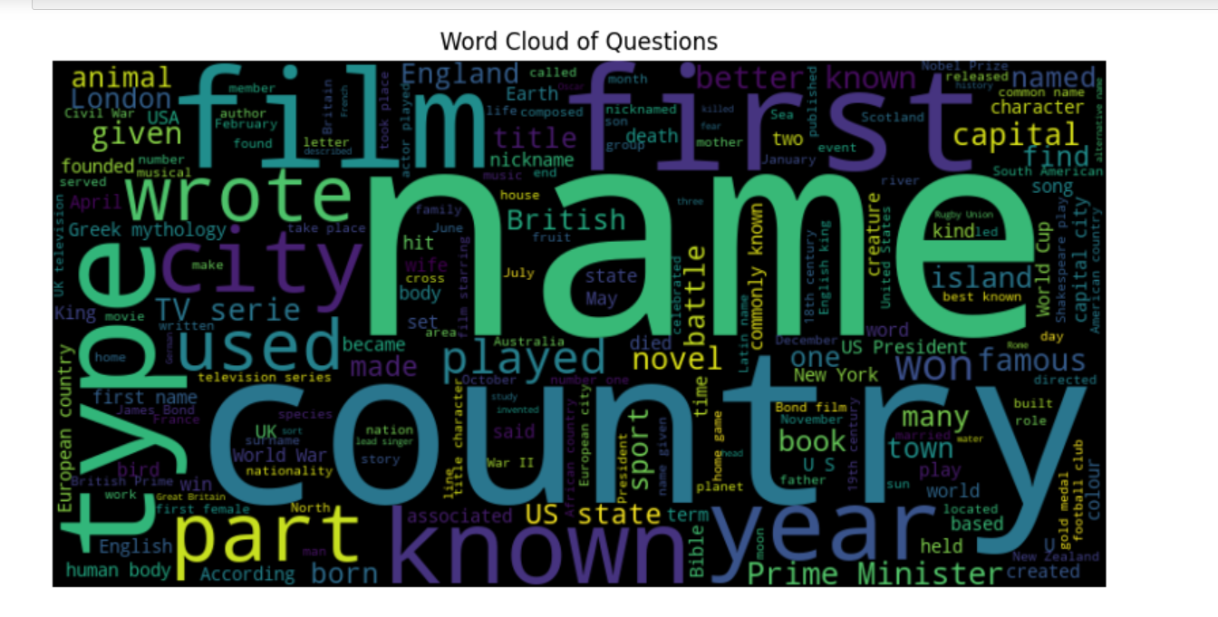

Slide 9
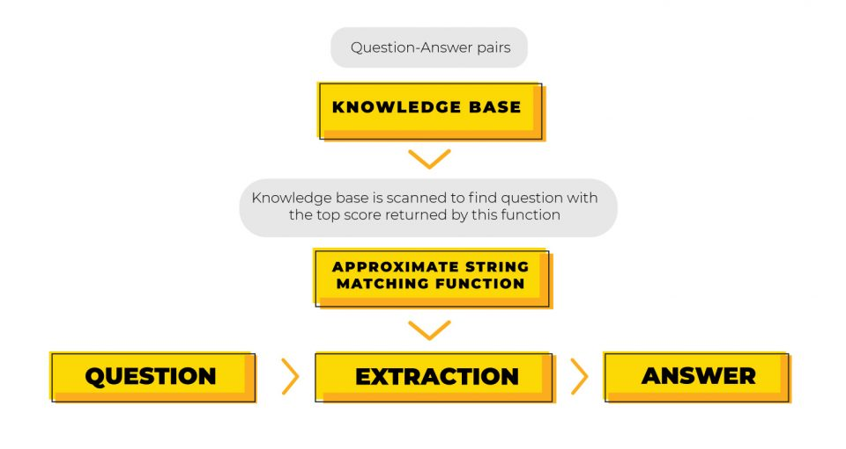
Model Architecture

Slide 10
Baselines
For our metric we will use accuracy of answers.
As baselines to compare to, previous implementations stated their neural network and SQuAD (Stanford Question Answering Dataset) performed at 23% and 40% accuracy respectively, while human performance for this task is at 80% accuracy (Joshi 2017).
The goal for our model is to explore other neural network architectures and pretrained-language models to see if we can improve upon the previous achieved accuracies, and best case scenario be close or more than human achieved accuracy.

Slide 11
Training Process
Splitting the Dataset
Preprocessing the Labels
Tokenizing and Padding the Questions
Model Architecture
Model built using Keras
Glove
Compiling the Model
Training the Model

Slide 12
Training Challenges & Solutions
Computational Resources
Fine-tuning Pre-trained Models
Long and Complex Questions
Lack of Contextual Understanding
Ambiguity and Variability in Questions

Slide 13
Results - Performance Metrics
Neural Network Model using Keras Sequential API
Test Loss - 0.7
Test Accuracy - 0.96
Glove:
Test Loss - 0.7
Test Accuracy - 0.945

Slide 14
Outcomes
Much higher accuracy than previous models with this dataset
Outperformed human response by about 15%
The model successfully handled challenges related to complex question semantics, reasoning, and information extraction.

Slide 15
Limitations
Hardware Limitations
Software Compatibility
GPU Memory Limit
Code Optimizations
Debugging Challenges
Learning Curve

Slide 16
In Conclusion: Future Improvements
Explore more pre-trained word models like GPT-3
Accumulate a larger dataset to train the models on
Incorporate human error in the model to better match human accuracy
Notes:
mike

Slide 17
In Conclusion: Real World Applications
A bot that can answer a wide variety of questions as we see in ChatGPT and Siri/Alexa
A bot that can model human trivia performance for research purposes
Identify topics that are difficult or lacking accessible information
Notes:
mike

Slide 18
Any Questions?
Notes:
mike

Slide 19
Works Cited
Joshi, M., Choi, E., Weld, D. S., & Zettlemoyer, L. (2017, May 13). Triviaqa: A large scale distantly supervised
challenge dataset for reading comprehension. arXiv.org. https://arxiv.org/abs/1705.03551

Slide 20
Thank You
Notes:
mike

